Slide 1
2011 Virtual Tour
Activity Update
Johnson County Weed & Pest

Slide 2
Programs & Projects
Whitetop
Coupons
Rock Creek Grant
Muddy Creek Grant
FS & BLM
S. thistle, Knapweed
Prairie dogs
Mosquitoes
Education programs
Field Certifications
County Roads
Comped weeds/pests
Salt cedar
Bio-control
Spurge treatment
GIS
Equipment upgrades
Wy DOT
Russian Olive

Slide 3
Funding
FY 10/11 | General | Leafy Spurge
Total Budgeted | $3,249,511.00 | $2,275,215.00
Actual Income | $3,503,048.52 | $2,355,567.30
Actual Expenses | $932,785.34 | $416,043.94
Emergency Reserve | $2,000,000.00 | $1,500,000.00
Carryover to FY 11/12 | $570,263.18 | $439,523.36

Slide 4
Expenses Breakdown
FY 10/11 | LS/SC | General | Total | Percentage
Admin | $57,031.06 | $55,129.06 | $112,160.12 | 8.3%
Seasonal crews | $58,518.96 | $59,863.43 | $118,382.39 | 8.8%
Office | $0 | $16,942.88 | $16,942.88 | 1.2%
Operating | $0 | $50,244.54 | $50,244.54 | 3.7%
Programs | $300,493.92 | $706,397.96 | $1,006.891.80 | 74.7%
Other | $0 | $12,109.77 | $12,109.77 | 0.9%
Insurance | $0 | $2,709.00 | $2,709.00 | 0.2%
Cap outlay | $0 | $29,388.70 | $29,388.70 | 2.2%
TOTAL | $416,043.94 | $932,785.34 | $1,348,829.20

Slide 5
Expense breakdown- previous year
FY 09/10 | LS/SC | General | Total | Percentage
Admin | $50,604.88 | $52,800.68 | $103,405.56 | 4.2%
Seasonals | $43,726.99 | $72,583.18 | $116,310.17 | 4.6%
Office | -0- | $13,974.28 | $13,974.28 | 0.6%
Operating | -0- | $54,267.46 | $54,267.46 | 2.2%
Programs | $177,544.55 | $1,992,192 | $2,169,736 | 86.2%
Other | -0- | $9,017.83 | $9,017.83 | 0.4%
Insurance | -0- | $5,038.75 | $5,038.75 | 0.2%
Cap Outlay | -0- | $41,551.92 | $41,551.92 | 1.6%
TOTAL | $271,876.42 | $2,241,625 | $2,513,502

Slide 6
Points to compare yearly expenses
Cost of insurance went up significantly and added to admin cost driving that cost up instead of insurance
Operating costs went down, which includes fuel, warehouse supplies, equipment repair and equipment leases.
Other includes building improvements, utilities, postage, freight, and sales tax.
Office expenses include out of town meeting costs, Council dues, advertising, office equipment repair & supplies, and education or PR costs.
Capital outlay costs went down
Big grasshopper program in 2010 drove up program cost that year.

Slide 7
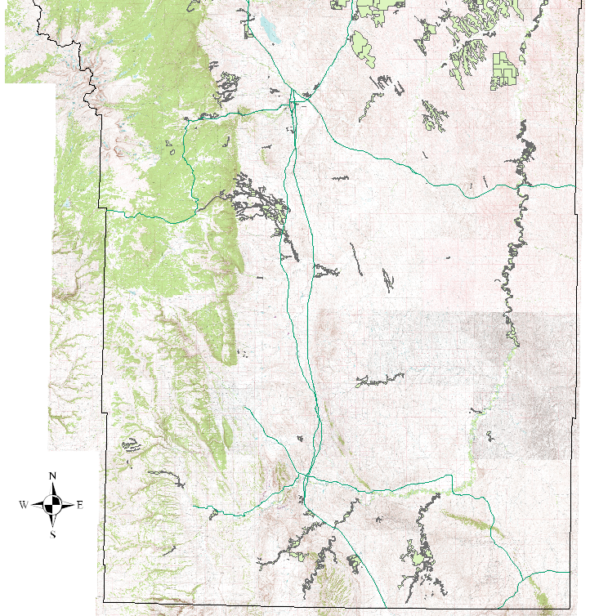
2011 Coverages
Acres treated- 4,817
Acres covered- 84,091

Slide 8
Acres treated by Year

Slide 9
Dollars spent per year by weed

Slide 10
Vendor Coupons Issued

Slide 11
Leafy Spurge Acres Treated

Slide 12
Crew dynamics
Mosquito technician-one man
5 man foot crew with ATV
5 man foot crew without ATV
Rover- treated county roads, some grasshoppers and filled in where needed
Two man ATV crew for range work
Contract helicopter for spurge and salt cedar
Contract crew for DOT contract
Contract ATV crew for salt cedar
Me

Slide 13
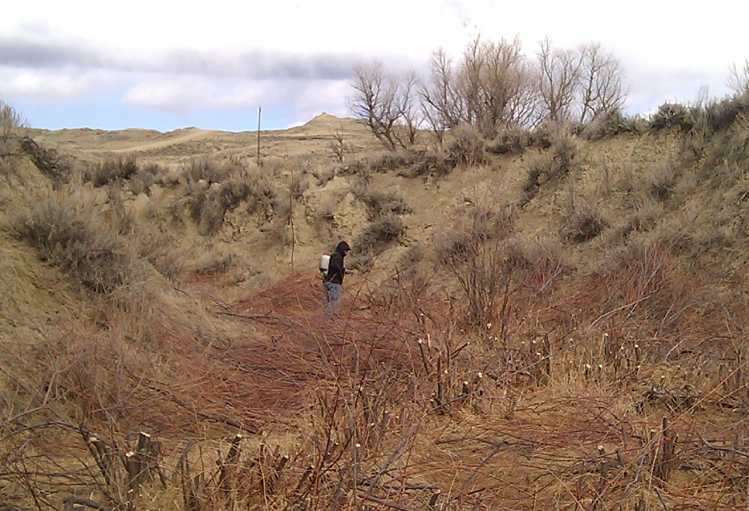
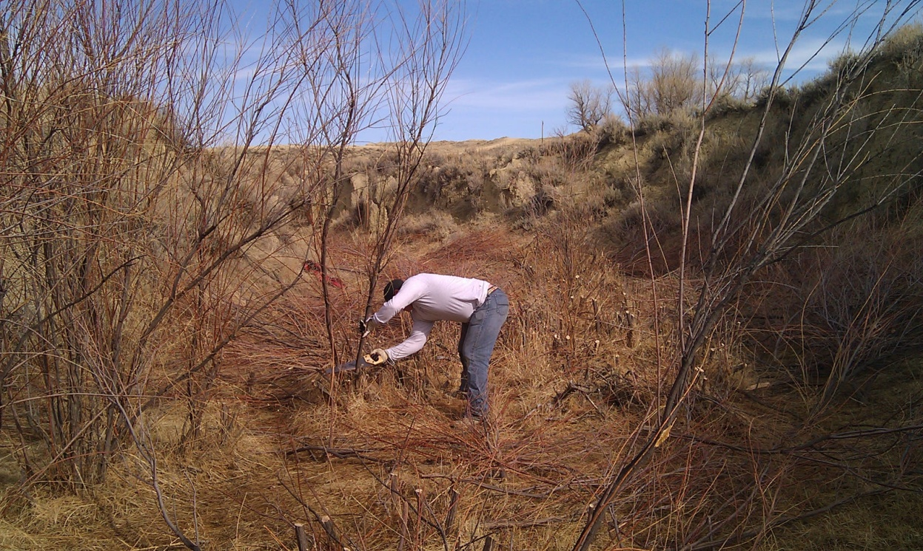
College kids “Spring break” hand cutting and treating salt cedar.

Slide 14
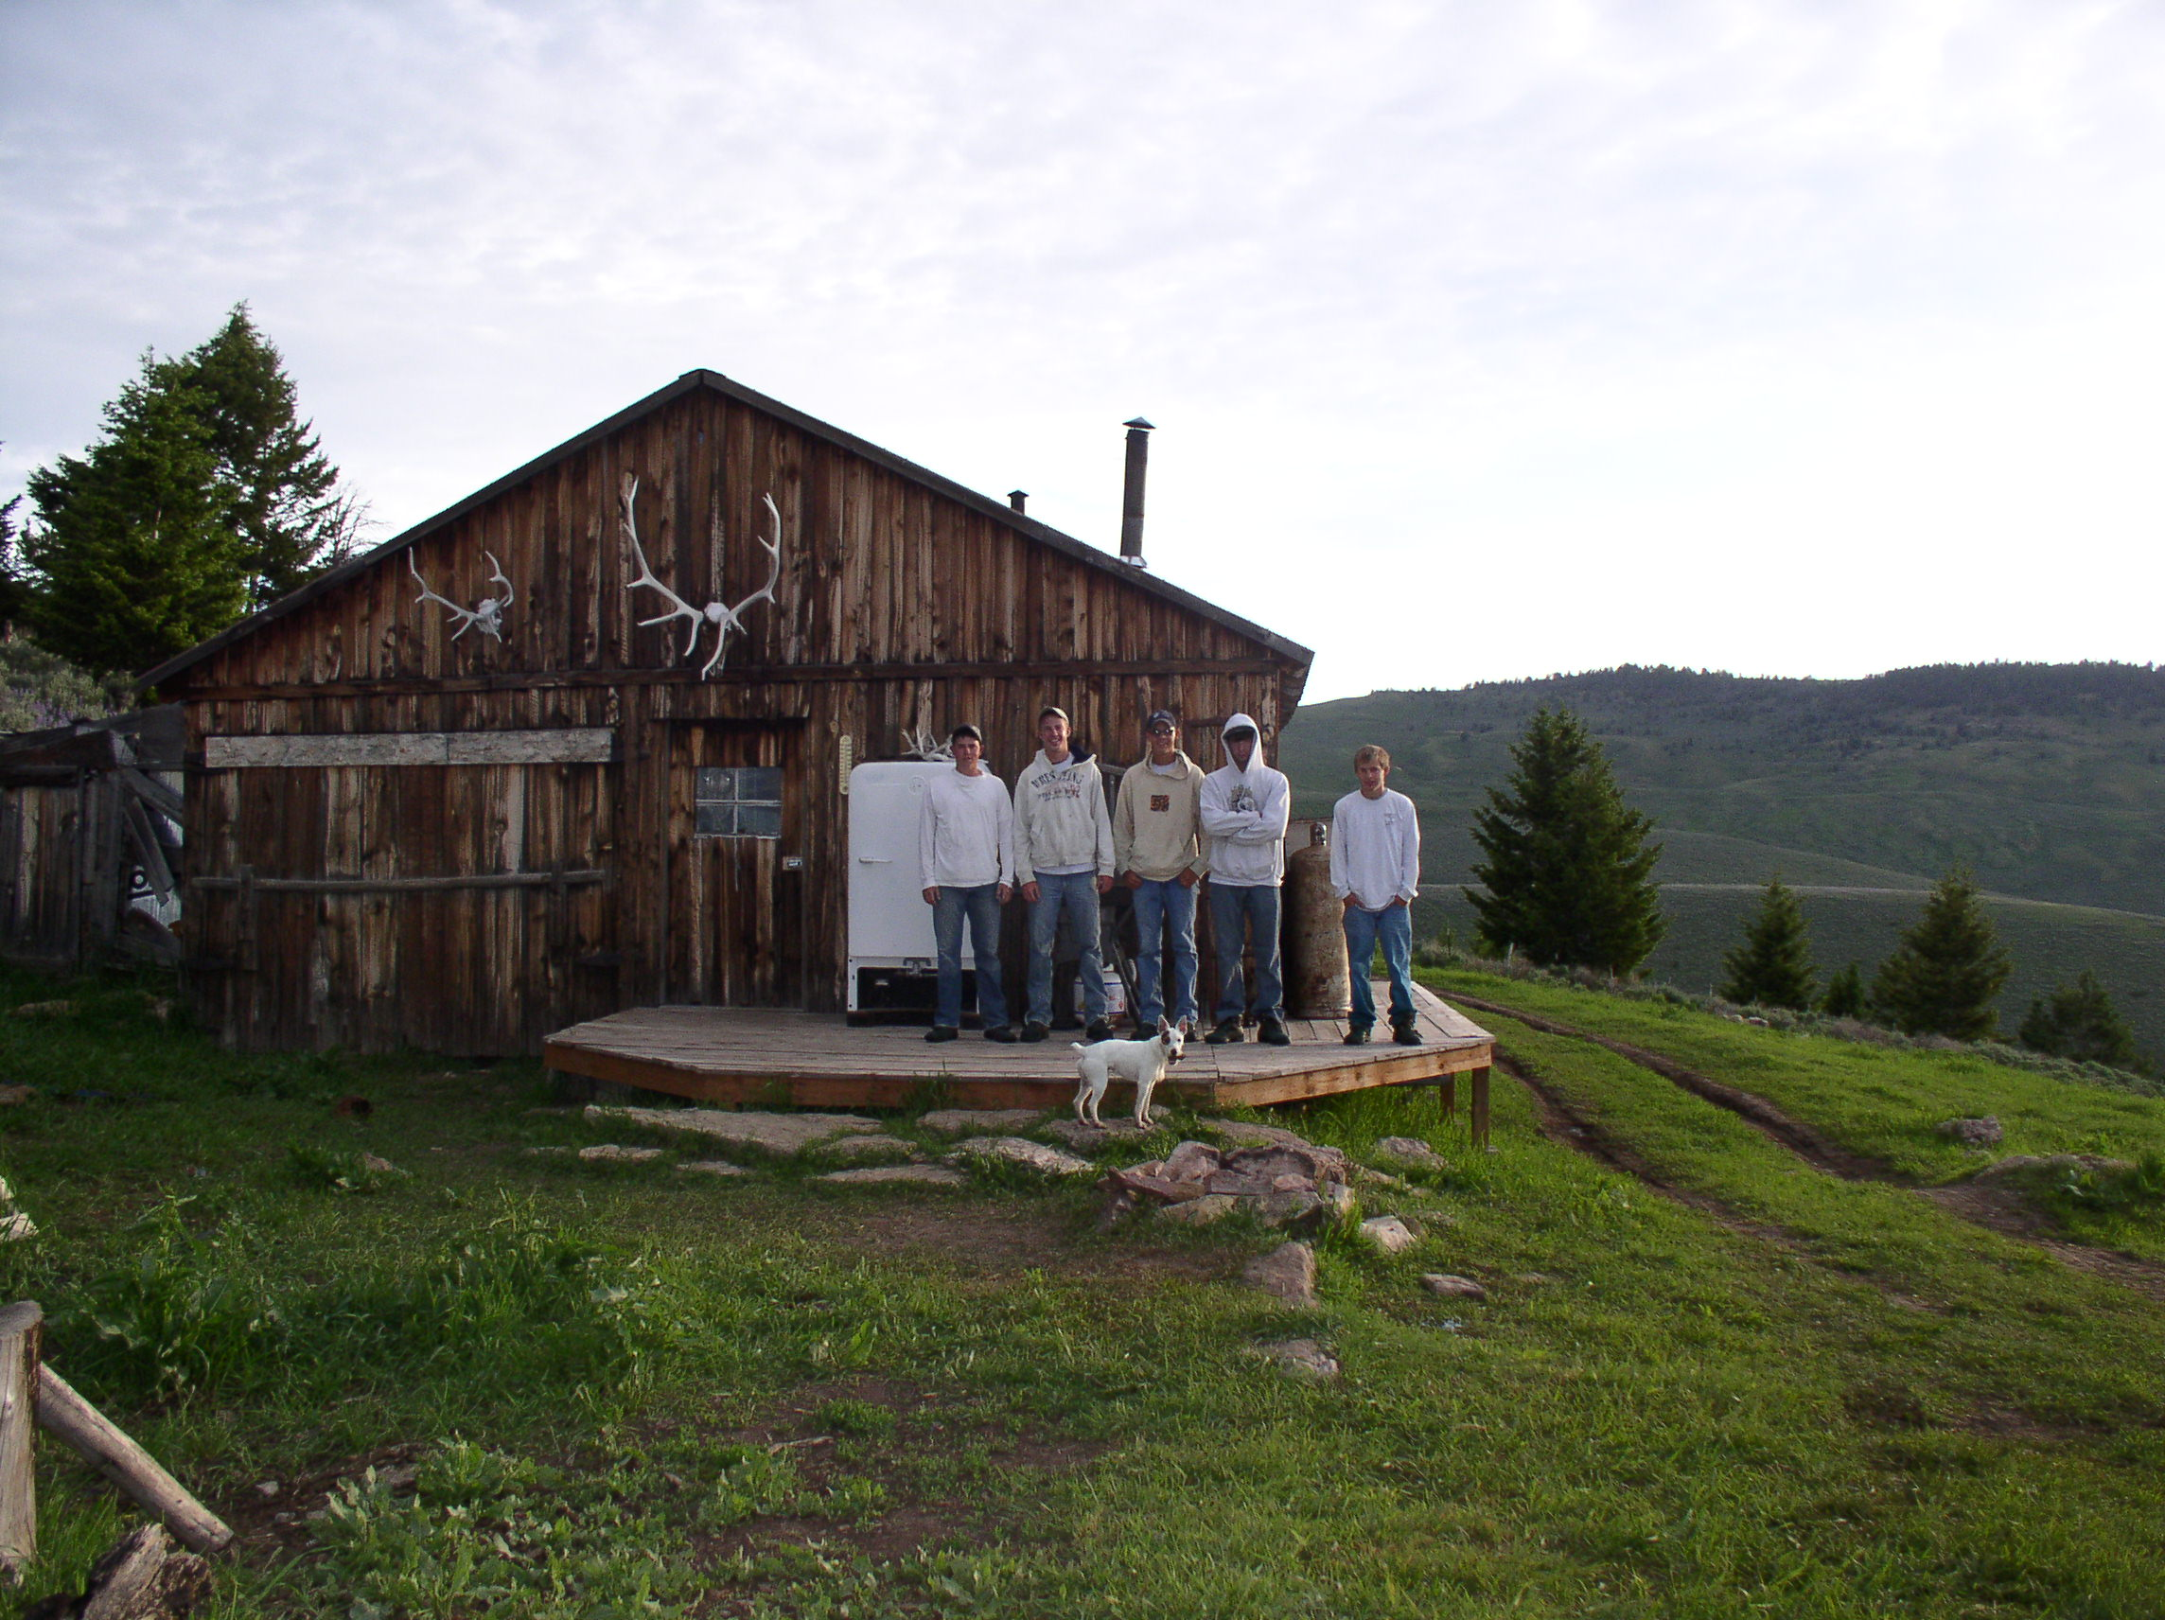
The crew in camp before heading out for the 3rd and final day of treating larkspur.

Slide 15
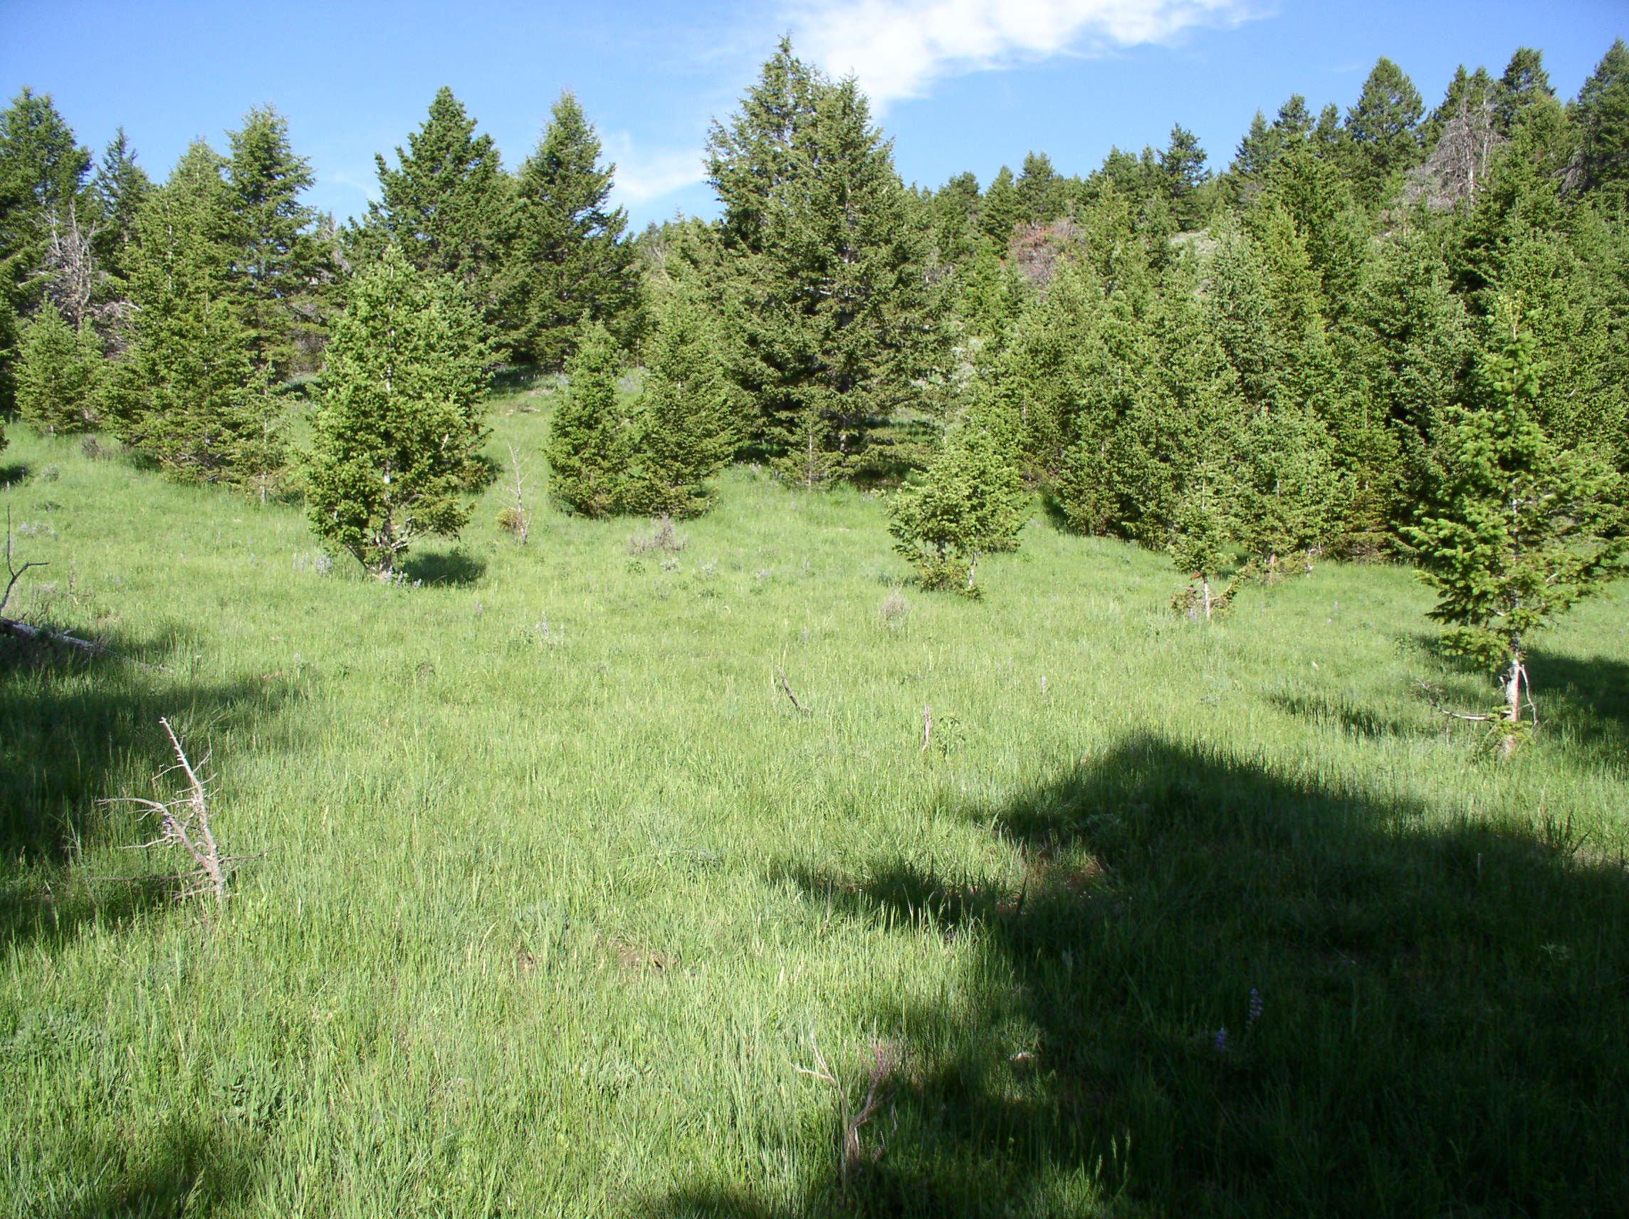
Tall larkspur treatment area
Believe it or not this was solid larkspur 2 years prior

Slide 16
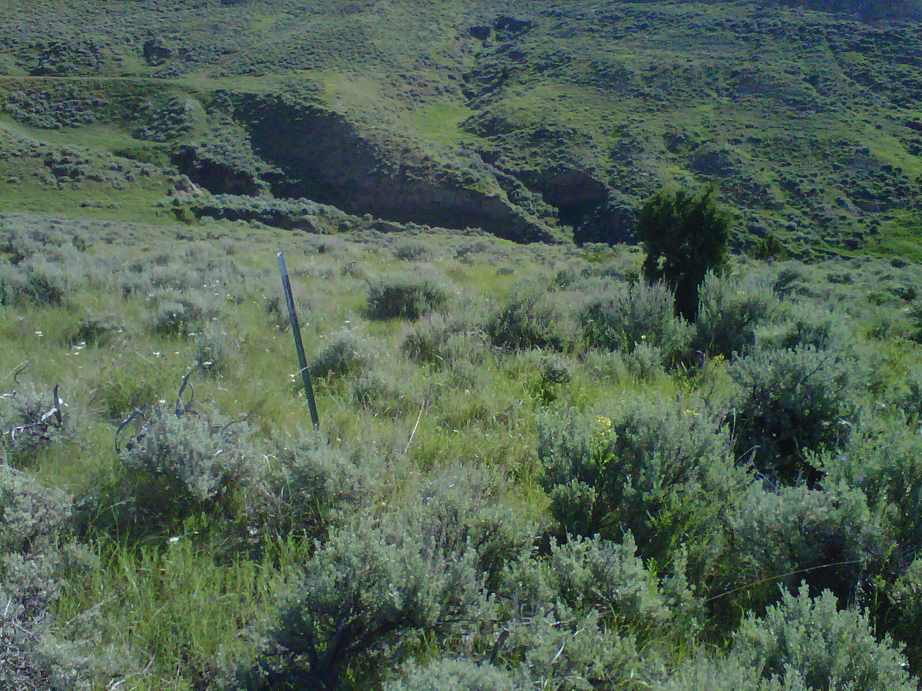
One of our first insect release sites on leafy spurge in the early 1990’s
As viewed in June 2012. this area has only been treated with herbicides
A couple times since release. Insects effectively managing the infestation.

Slide 17
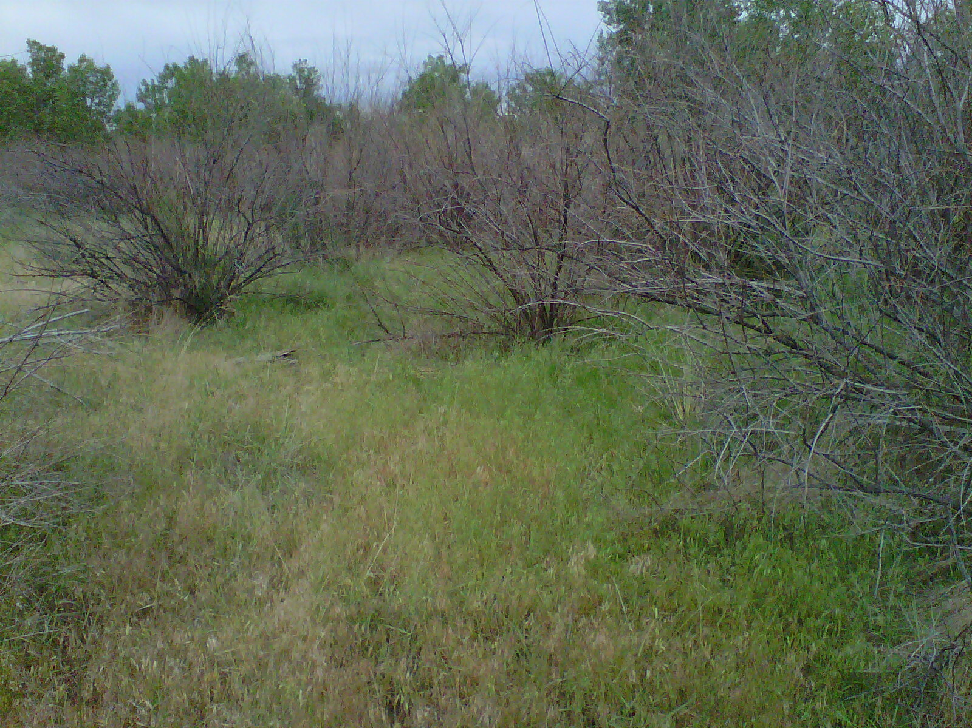
North end Powder River uncut, aerially treated.
Some re-growth from root crown, 1 yr after treatment.

Slide 18
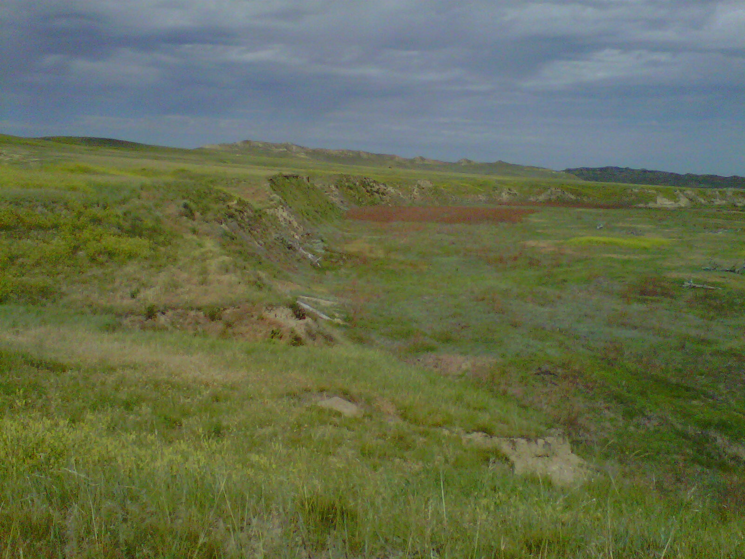
North end of Powder River, had been cut, re-growth sprayed aerially.
Can’t tell in photo but there is about 20% re-growth, 1 yr after treatment

Slide 19
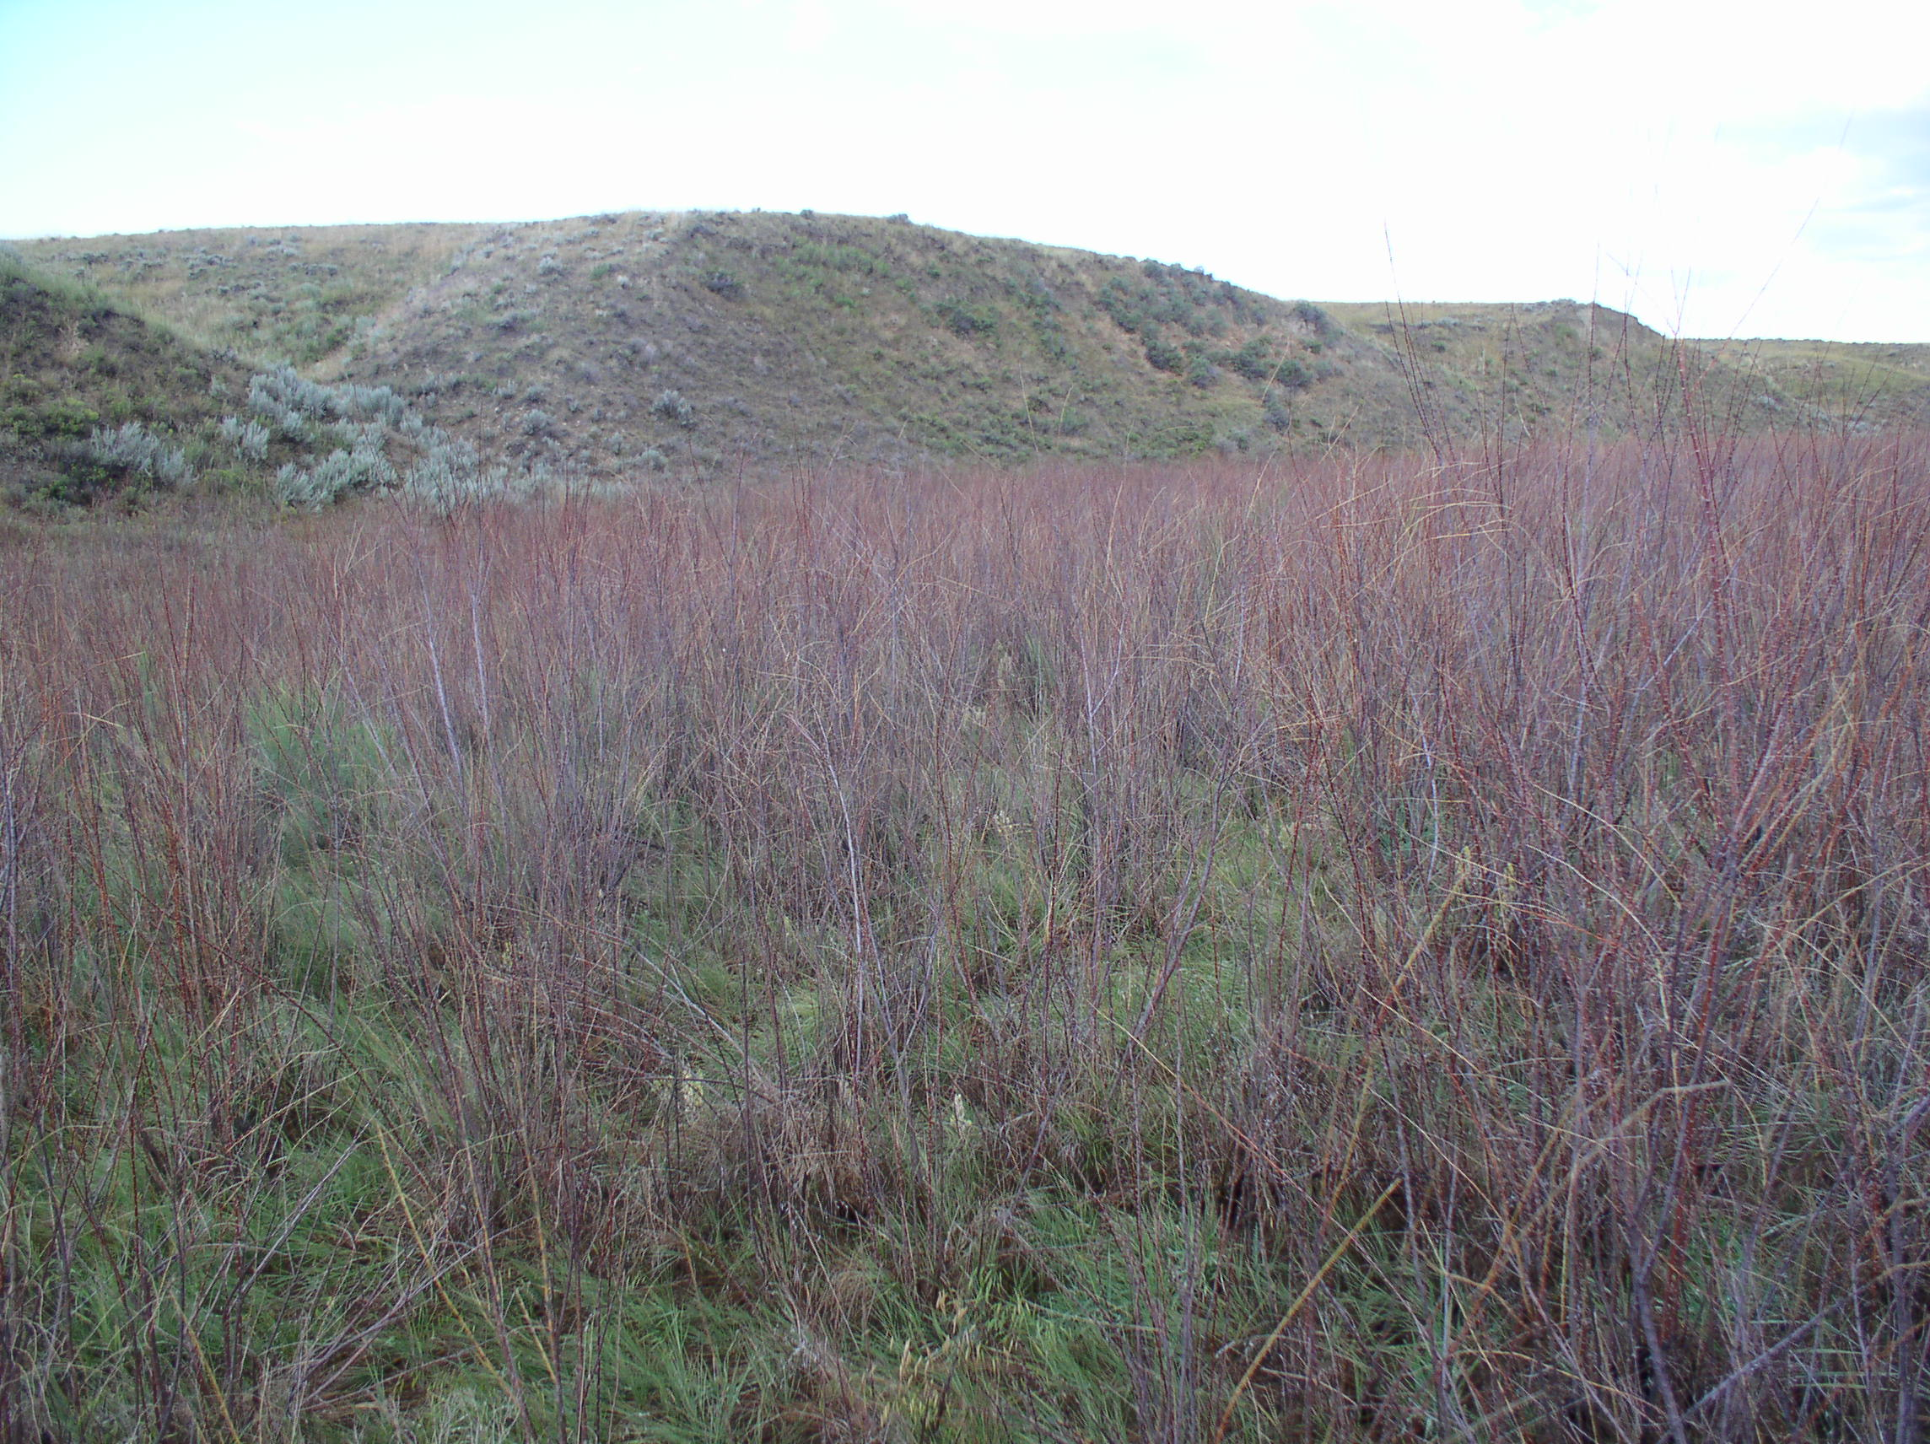
Close up shot of area in previous slide

Slide 20
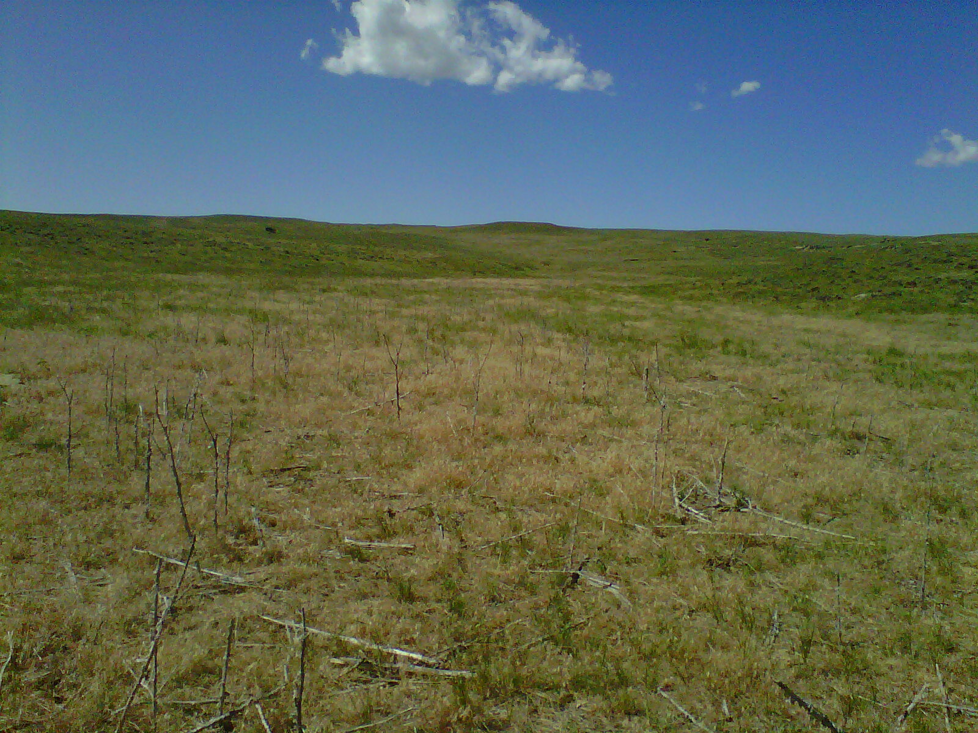
Scotch thistle control one year after treatment
This site was actually solid thistle 5 feet tall across this draw the year prior

Slide 21
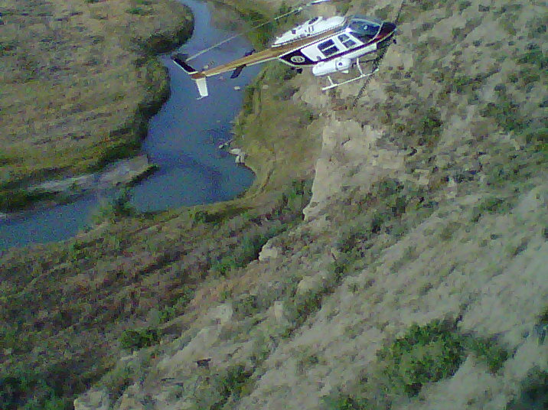
Impressive skills of aerial applicator spraying Salt cedar on Salt Creek

Slide 22
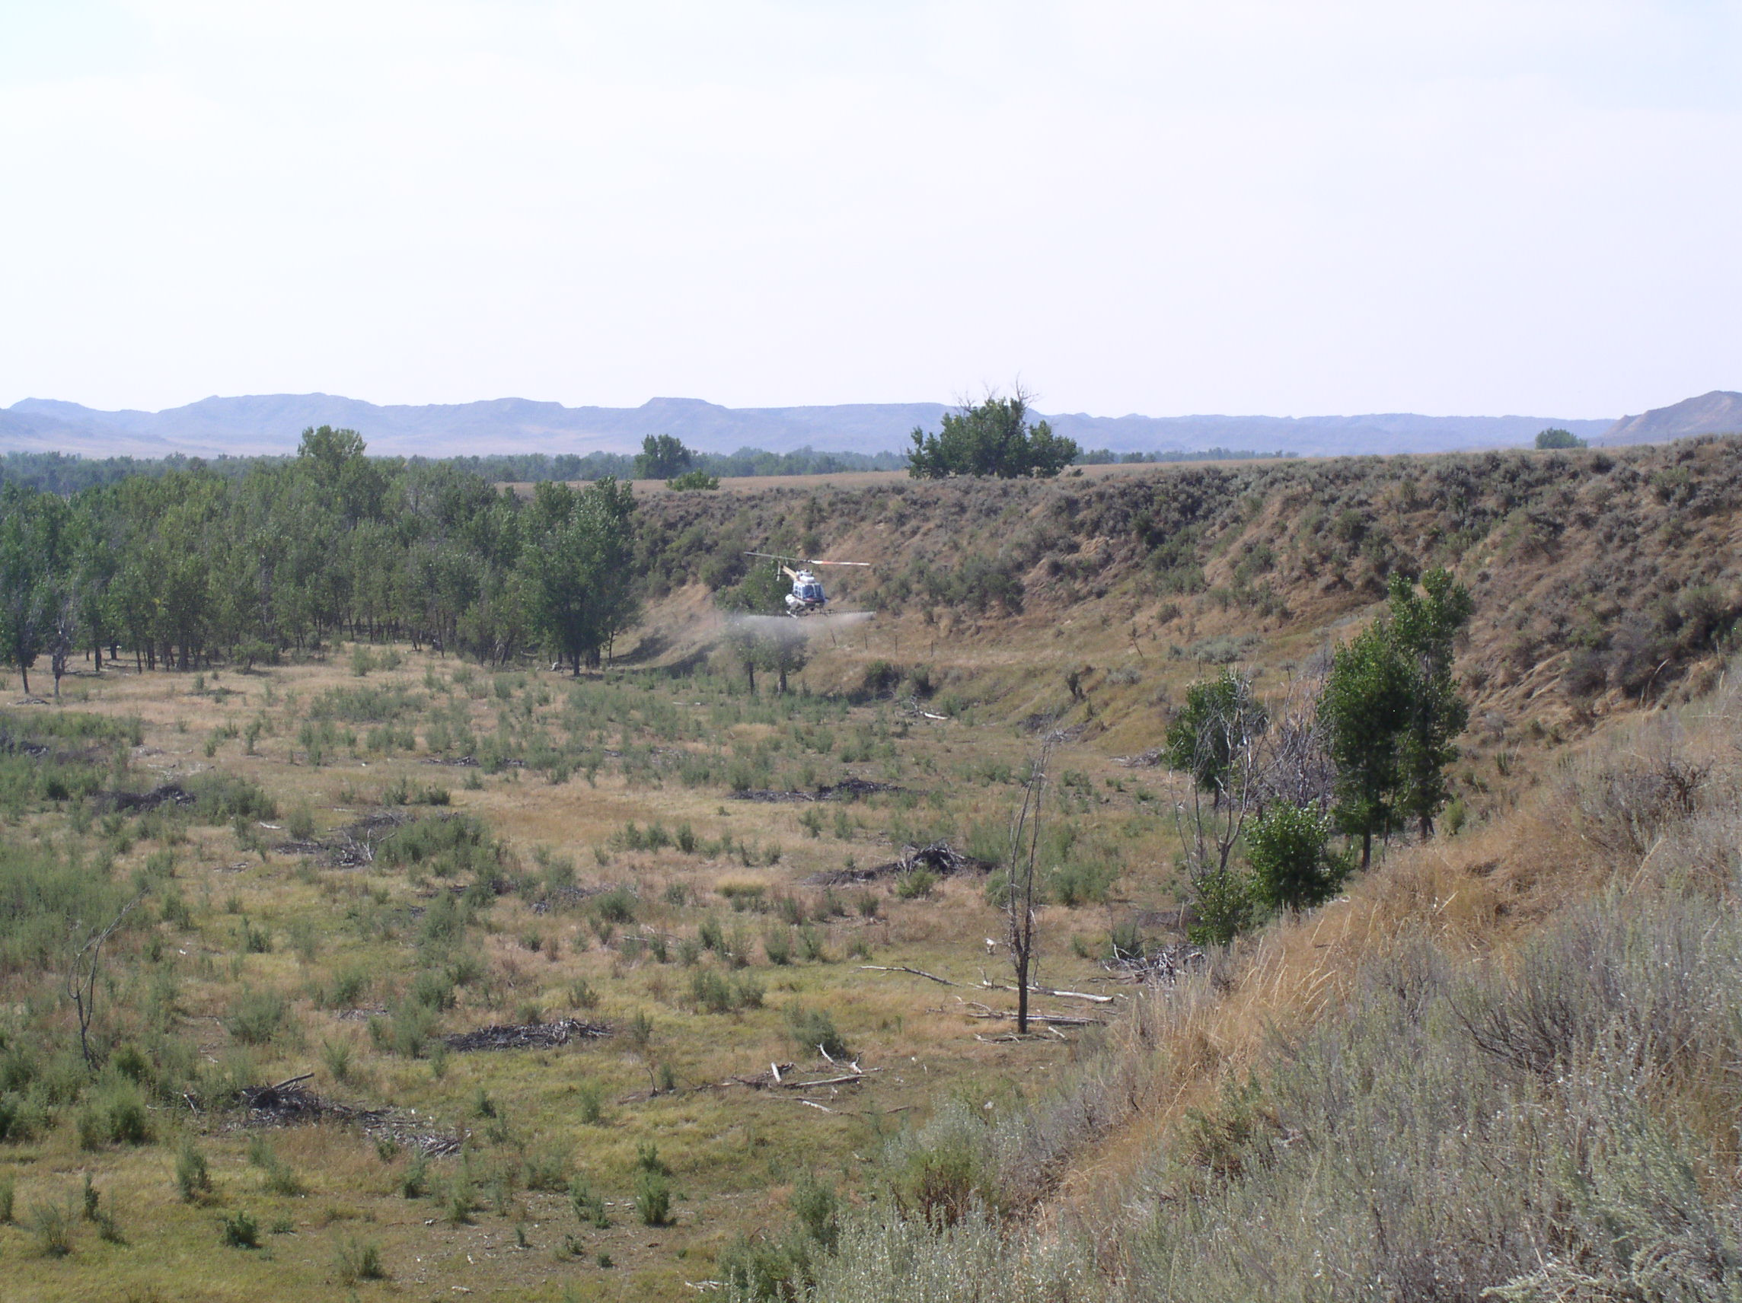
Aerial treatment of re-grown salt cedar post cutting.

Slide 23
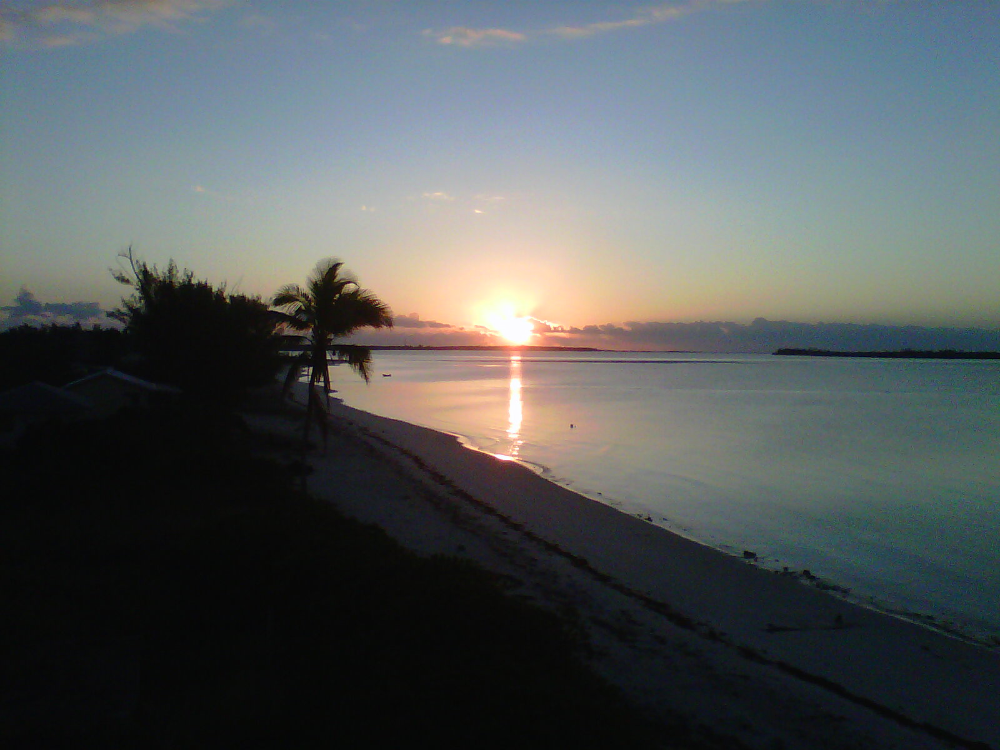
Vacation Sunrise!

